Slide 1
Content-Based Image Retrieval

Slide 2
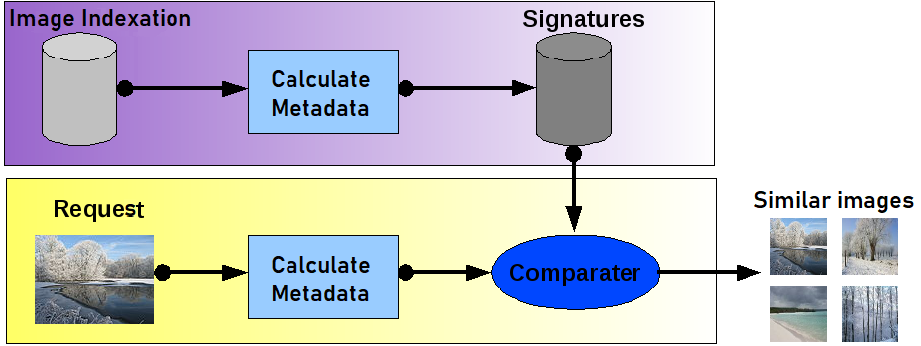
What is content-based image retrieval?
The task: retrieve images with from a large database using a query by image content
Has similarities to image classification and face identification problems, yet focuses on scaling to huge image collections via approximate methods

Slide 3
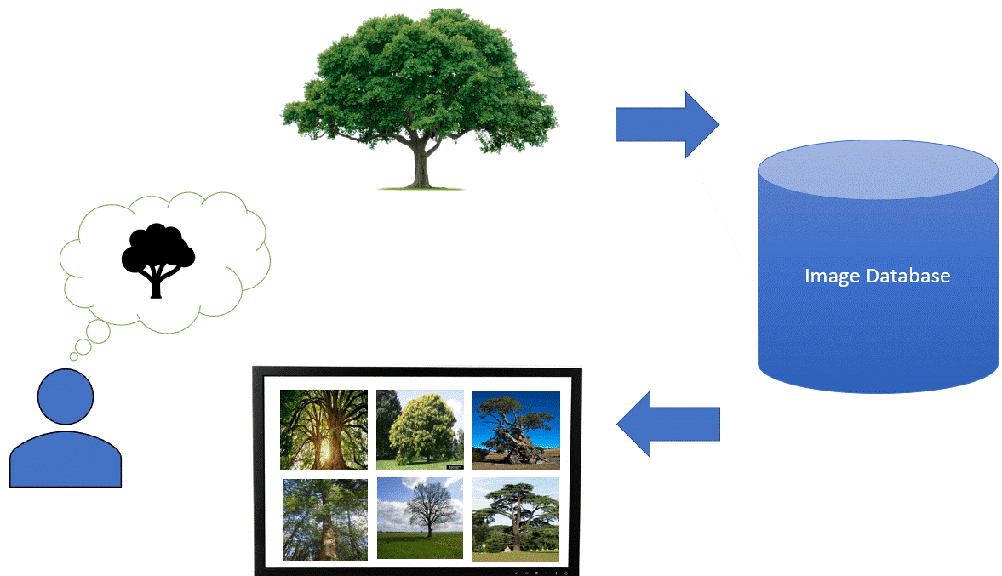
Querying the CBIR system
Query via image caption of text description
“Funny cats photos" - need images
Requires categorized or annotated images
Query using an example image (search for "the same" image)

Slide 4
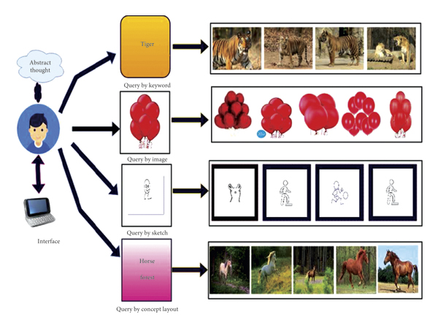

Slide 5

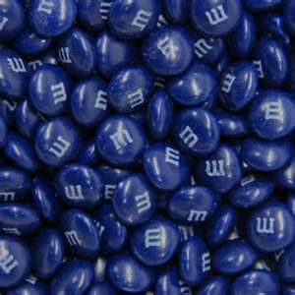


Querying the CBIR system
Query in the form of content features
Color histogram: search for "dark blue" content
Query using sketch

Slide 6
Definition of image similarity
Content feature similarity (e.g., color similarity)
Near-duplicates: subtly changed image (colors, compressed)
Object retrieval: output the same object or scene
Images visually similar by the scene geometry
Category level classification: retrieve images of the same scenes or objects with high visual distinctiveness

Slide 7
Features
Color (histograms, gridded layout, wavelets)
Texture (Laws, Gabor filters, polarity)
Shape

Slide 8


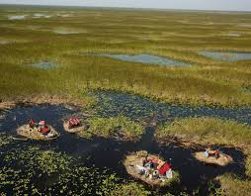


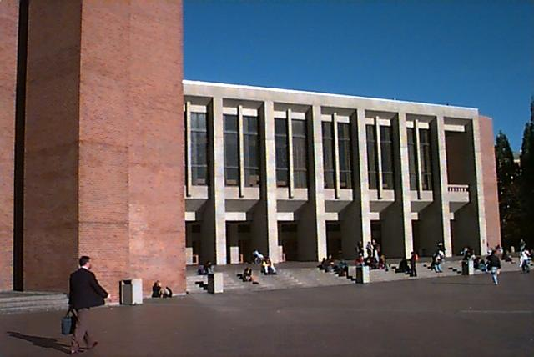

Image Features / Distance Measures
Query Image
Retrieved Images
User
Image Database
Distance Measure
Images
Image Feature
Extraction
Feature Space

Slide 9
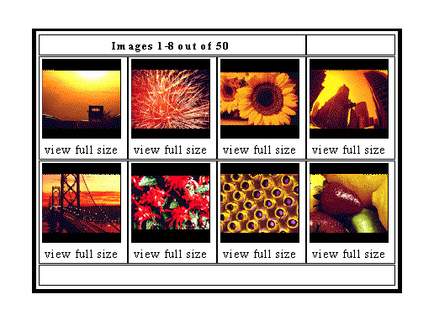
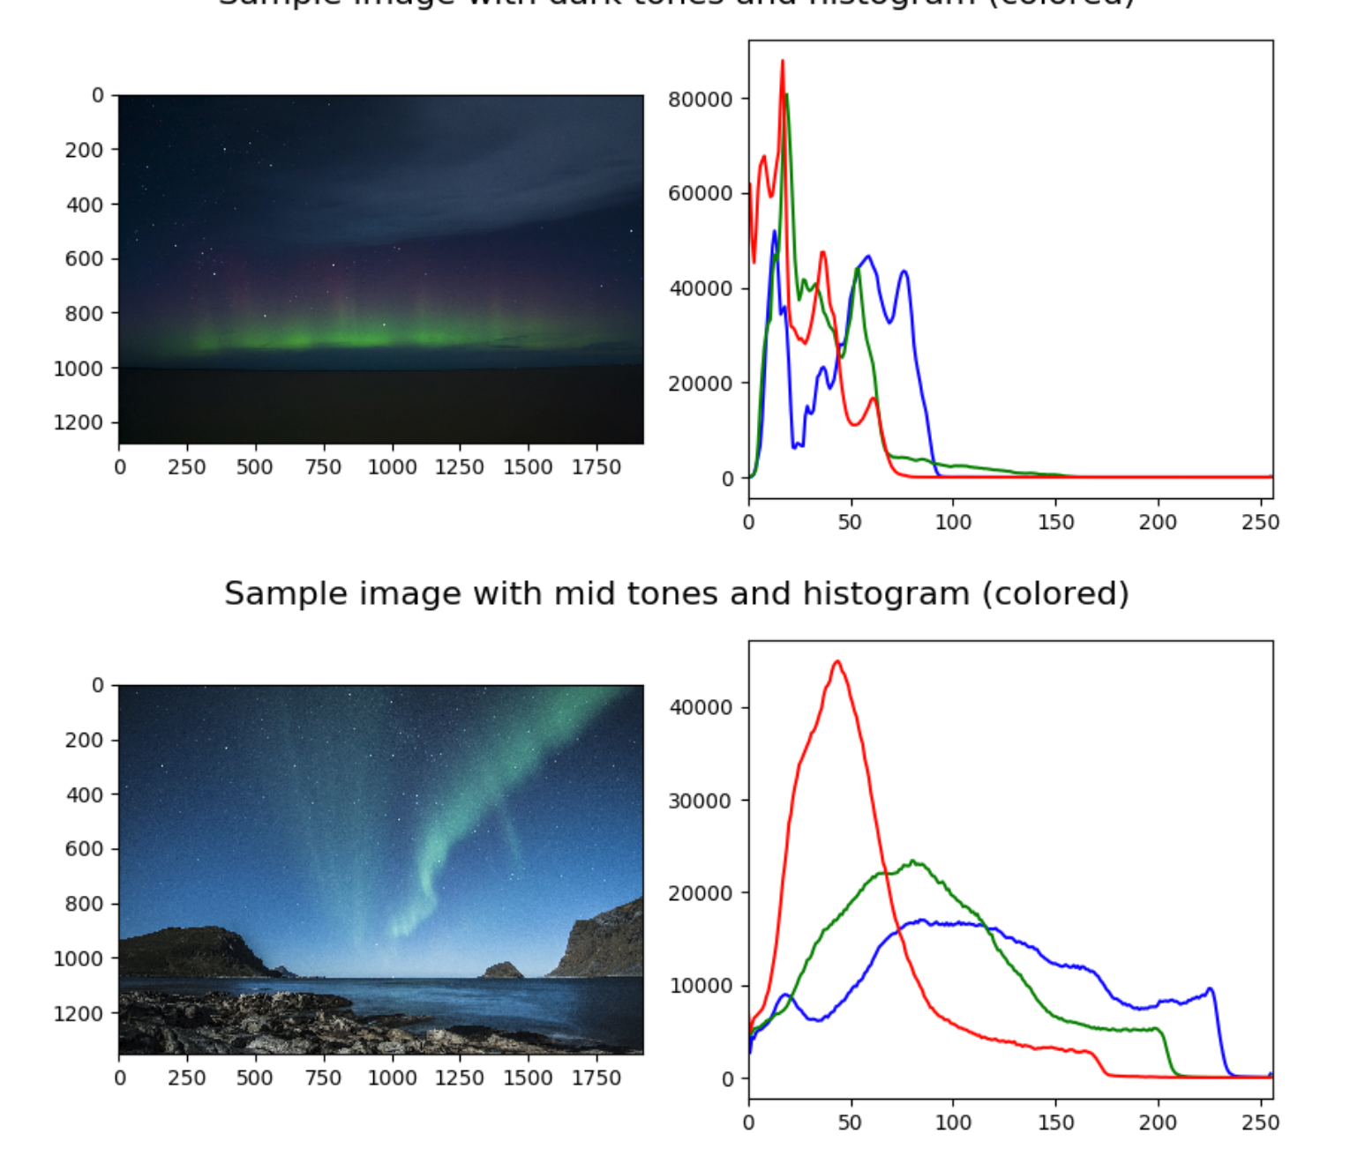
Color Histograms

Slide 10
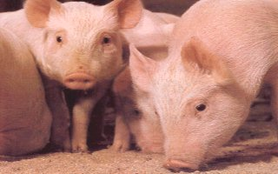
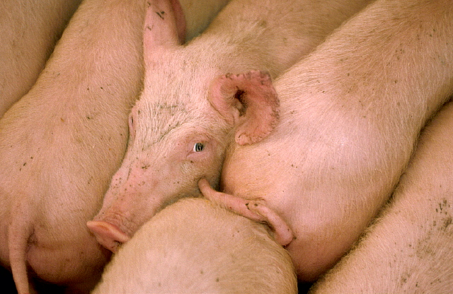
Gridded Color
Gridded color distance is the sum of the color distances
in each of the corresponding grid squares.
1
2
1
2
3
4
3
4

Slide 11
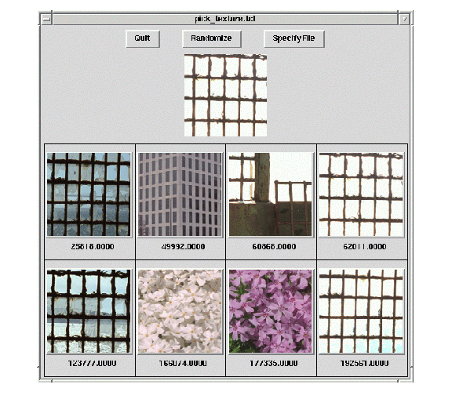
Laws Texture

Slide 12
Visual vs. semantic similarity
The choice of similarity yields different problem setups, depending on the similarity requirements
Different methods for different problem formulations
For an image retrieval system, utilize all sources of information and attempt to answer different interpretations of user query more fully

Slide 13
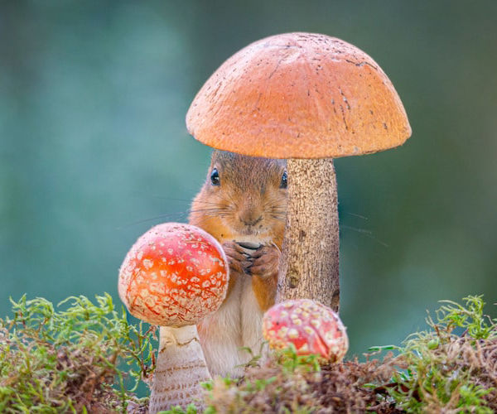



Content-Based Image Retrieval Pipeline
Indexing
Image collection
Image
features
Image
signature
Collection
index
Image
features
Image
signature
Search
the index
Search
results
Test image

Slide 14
Summary
Content-based image retrieval: search & retrieve images from large databases
Definition of similarity matters for retrieval
CBIR systems extract image descriptors and perform efficient nearest neighbor search in giant image collections .

Slide 15
Thank you for your attention!

